Slide 1
Lecture 11/12
Control Schedule
Notes:
Chapter 4
PROJECT integration MANAGEMENT

Slide 2
General Observations
In top and middle level management’s opinion, It's always somebody else's fault. Blame it on someone.
The lower the level of the person, the more the finger points internally, rather than externally.
People complain about lack of sufficient supervision of the vendors, but at the same time they also complain that they are so overloaded they barely have time to deal with fires.

Slide 3
Some Questions?
Why isn't the uncertainty properly factored into the original estimation?
Why are Companies so immersed in the mentality of saving money that they forget that the project is not to save money but to make money?

Slide 4
What is our normal experience from today's way of Project Management ?
Reliable on time in full to budget delivery performance ?
Or A continuous struggle with time, cost and scope ?
A stable plan
Or Repeated rescheduling ?
Simple, objective measures of Project progress ?
Or Clarity at the start and end, thick fog in between ?
Simple, objective measures of Project health status ? Or Subjective assessments compounded by human factors ?
Clear signals for when corrective action is - and is not - necessary ?
Or Intervening too much too early, and too little too late ?
Direction for ongoing improvement efforts ?
Or "We'll improve our methods when things get better"

Slide 5
'Normal' Practice in the planning phase
We identify the tasks in the Project and specify the resources needed for each one
We allocate to each task sufficient time that we are confident will allow it to be completed with those resources. That is, the time the task should take on average, plus some contingency to give us the confidence we seek
We apply task dependencies, and work out the longest path of tasks in the Project
The time along this path is the time-line of the Project

Slide 6
Normal practice in the execution phase
As long as every task completes on time (within its contingency), its successors will be started on time
As soon as any task finishes late (outside its contingency), its successors will start late, and this normally means they will finish late
In order to rescue a Project which shows any lateness, we have to squeeze the remaining tasks in the Project
Typically we have to compromise on time, cost or scope and reschedule

Slide 7
How long should we allow in the plan for a task ?
Some staff work more quickly than others
Sometimes staff are distracted or interrupted
Sometimes necessary resources are delayed
Some staff are risk-averse in their commitments
Some organisations reinforce risk-aversion
Strikes etc

Slide 8
How long do we allow in the plan for a task ?
The average time the task ought to take an average performer who focuses on it
PLUS The time we expect to be spent on distractions
PLUS A contingency time to take account of:
The spread between average and low performers
Our uncertainty in the average time
Our uncertainty in the time for distractions
How risk-averse we are or have to be

Slide 9
Don't overreact to buffer erosion
We expect our buffer to be used up over the course of the Project
Our date is not threatened if the buffer is used up in proportion to progress
If we have 2/3 of the completion buffer left and only 1/3 of the Project to do we are doing fine
Our date is threatened if the buffer is used up disproportionately

Slide 10
Measures Summary
We have simple, objective measure of Project progress
We have a simple, objective measure of Project health status
We have a simple rule for triggering - and not triggering - corrective action
We can redefine the Project progress meeting as the Buffer Management Meeting

Slide 11
Buffer Management Meeting
Attendees: Project Manager, Project Sponsor / Owner, Task Managers, Resource Managers
Agenda:
Reminder of what tasks are on the Critical Chain.
Review Project status ( % Critical Chain outstanding).
Review Completion buffer status (Red, Amber, Green).
If necessary, initiate corrective actions.
Review Feeding buffers status (Red, Amber, Green). If necessary, initiate corrective actions.
Review tasks in progress to ensure earliest completion in full.
Review tasks not started to ensure earliest start where appropriate.

Slide 12
Using Buffer Management to drive ongoing improvement
Buffer Management measures are fact-based and objective
Buffer Management meetings highlight buffer erosion / Project delays
Preventing the causes of delay will speed up your Projects
Your process of ongoing improvement is simply to eliminate the causes of delay by following up on the issues highlighted in Buffer Management meetings
As your Projects run faster and more reliably, continue to eliminate more and more causes of delay

Slide 13
Control Schedule
Schedule control is concerned with:
Determining the current status of the project schedule,
Influencing the factors that create schedule changes,
Determining that the project schedule has changed.

Slide 14
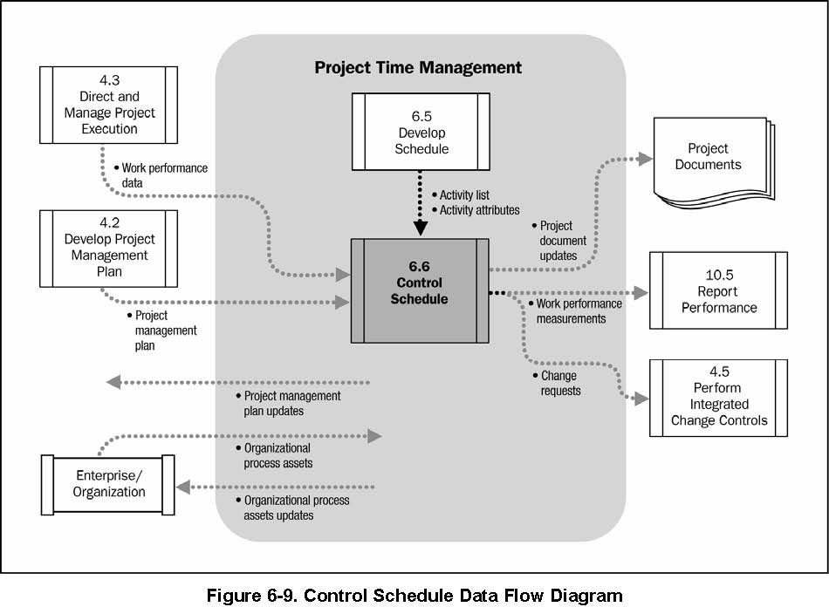
Control Schedule

Slide 15
Control Schedule

Slide 16
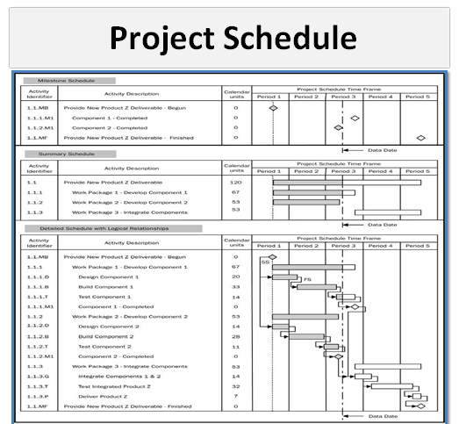
INPUTS

Slide 17
Monitoring & Controlling
and
Time
Tools & Techniques
Performance Reviews
Performance Reviews measure, compare, and analyze schedule performance.
An important aspect is to decide whether the variations effect the critical path and thus schedule baseline and need any corrective action
Earned Value Management (EVM)
Schedule Variance (SV)
Schedule Performance Index (SPI)
Critical Chain Method
Compare the amount of buffer remaining to the amount of buffer needed to protect the delivery date.
Notes:
Review Actual Vs Planned or Baseline
Actual start date and finish date.
Percent complete and remaining duration.
Performance Reviews usually have two methods
Earned Value Management (EVM)
Critical Chain Method

Slide 18
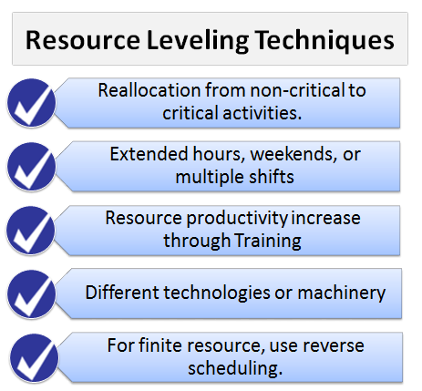
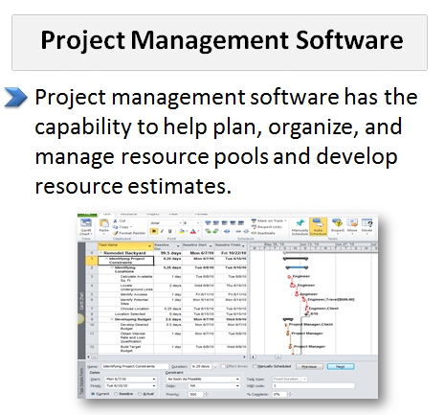
Monitoring & Controlling
and
Time
Tools & Techniques

Slide 19
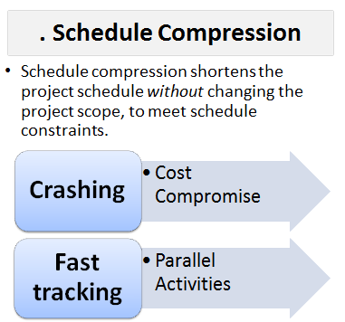
Monitoring & Controlling
and
Time
Tools & Techniques

Slide 20
Monitoring & Controlling
and
Time
Outputs
1. Work Performance Measurements
The calculated schedule variance (SV) and schedule performance index (SPI) values for WBS components, in particular the work packages and control accounts, are documented and communicated to stakeholders.

Slide 21
Monitoring & Controlling
and
Time
Outputs
2. Organizational Process Assets Updates (OPA+)
Lessons Learned
Causes of Variances
Updates
Corrective Actions with Reasons
1. Processes and Procedures
Formal and Informal Plans
Policies , guidelines and Templates
.2 Corporate Knowledge Base
lessons learned
historical information
Learning from previous projects
completed schedules, risk data, and earned value data
Change Control Procedures
Configuration Management

Slide 22
Monitoring & Controlling
and
Time
3. Change Requests
Change requests are issued during Execution which may expand, adjust, or reduce project scope to modify project policies or procedures, to modify project cost or budget, or to revise the project schedule.
Other change requests cover needed preventive or corrective actions to forestall negative impact later in the project.
Corrective actions.
Preventive actions.
Defects.
Updates.
Direct
Indirect
External
Internal
Optional
Legal/ Contractual

Slide 23
Monitoring & Controlling
and
Time
4. Project Management Plan Updates
Elements of the project management plan that may be updated include but are not limited to:
Schedule baseline
Schedule management plan
Scope baseline
Cost baseline

Slide 24
Monitoring & Controlling
and
Time
5. Project Document Updates
Project documents that may be updated include but are not limited to:
Schedule Data
Project Schedule
Documents

Slide 25
Project Time Management
Important formulae
Total Float (also called Slack, Float, or Project Float) is the total amount of time an activity can be delayed without delaying the project finish date.
Total float=LF-LS
Total Float-EF-ES
Free Float/Slack is the amount of time an activity can be delayed without delaying its successor (following activity).

Slide 26
Project Time Management
Important formulae
Free float=ES of Following activity-ES of present activity-Duration of present Activity
LS – ES: Calculates slack with forward pass
LF – EF: Calculates slack with backwards pass
EF=ES+duration-1
ES=EF+ 1
LS=Lf-duration+1
LF=LF of predecessor-1

Slide 27
Project Time Management
Important formulae
Lag Time: Inserted wait time between activities
Lead Time: Overlapping activities, also called paralleling or fast tracking.
“Lead In; Lag Out”
Precedence Diagramming Method (PDM) is also called Activity on Node (AON): Activities are in boxes
Most commonly used today
Has 4 relationships: F-S, S-S, F-F, S-F
No “dummies” (zero duration dependencies) allowed

Slide 28
Project Time Management
Important formulae
Can analyze using either Three-Point Estimates or CPM
Arrow Diagramming Method (ADM) Also called Activity on Arrow (AOA)
Only 1 relationship: F-S
Can have “dummies”
Can analyze using either Three-Point Estimates or CPM
Graphical Evaluation and Review Technique (GERT)
Allows loops and repetitive activities .

Slide 29
Project Time Management
Important formulae
PERT = PROGRAM Evaluation and Review Technique Holds schedule and lets cost float
3 estimates for each task: Optimistic, Pessimistic, and Most Likely
Mean Estimate = (O + 4*ML + P)/6
Standard Deviation (s) = (P – O)/6
Variance = s² , or [(P – O)/6]²
Order of Magnitude:-25% to +75%
Budget Estimate:-10% to +25%
Definitive Estimate:-5% to +10%

Slide 30
SCHEDULE VARIANCE
Formula for Schedule Variance (SV)
Schedule Variance can be calculated by subtracting planned value from earned value.
Schedule Variance = Earned Value – Planned Value
SV = EV – PV
From the above formula, we can conclude that:
If Schedule Variance is positive, this means you are ahead of schedule.
If Schedule Variance is negative, this means you are behind schedule.
If Schedule Variance is zero, this means you are on schedule.
When the project is completed Schedule Variance becomes zero, because at the end of the project all Planned Value has been earned.

Slide 31
SCHEDULE VARIANCE
You have a project to be completed in 12 months and the cost of the project is 100,000 USD. Six months have passed and 60,000 USD has been spent, but on closer review you find that only 40% of the work has been completed so far.
Find the project’s Schedule Variance (SV), and deduce whether you are ahead of schedule or behind schedule.?

Slide 32
SCHEDULE VARIANCE
Project Time Management
You have a project to be completed in 12 months and the cost of the project is 100,000 USD. Six months have passed and 60,000 USD has been spent, but on closer review you find that only 40% of the work has been completed so far.
Find the project’s Schedule Variance (SV), and deduce whether you are ahead of schedule or behind schedule.
Given in the question:
Actual Cost (AC) = 60,000 USD
Planned Value (PV) = 50% of 100,000
= 50,000 USD
Earned Value (EV) = 40% of 100,000
= 40,000 USD
Now,
Schedule Variance = Earned Value – Planned Value
= 40,000 – 50,000
= – 10,000 USD
Hence, the project’s Schedule Variance is -10,000 USD, and since it is negative, you are behind schedule.

